Slide 1

Business Analytics – The Science of Data Driven Decision Making

Slide 2
CHAPTER 3
INTRODUCTION TO PROBABILITY
© U Dinesh Kumar, IIM Bangalore

Slide 3
If you torture the data long enough, it will confess!
- Ronald Coase
© U Dinesh Kumar, IIM Bangalore

Slide 4
Probability Theory - Terminologies
© U Dinesh Kumar, IIM Bangalore

Slide 5
Random Experiment
Random experiment is an experiment in which the outcome is not known with certainty.
Predictive analysis mainly deals with random experiment like:
Predicting quarterly revenue of an organization
Customer churn
Demand for a product at future time period etc.
Business Analytics – The Science of Data Driven Decision Making

Slide 6
Sample Space
It is the universal set that consist of all possible outcomes of an experiment.
It is represented using letter “S”
Individual outcomes are called elementary events
Sample Space can be finite or infinite.

Slide 7
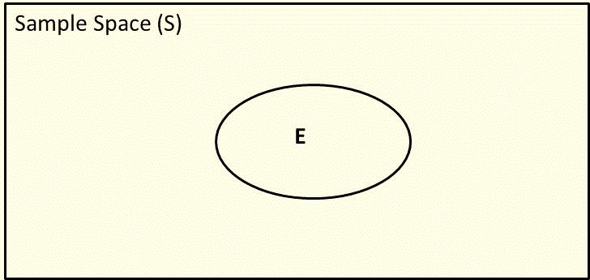
Event
Event(E) is a subset of a sample space and probability is usually calculated with respect to an event.
The Venn diagram indicates that the event E is a subset of the sample space S, that is, E ⊂ S (E is a subset of S)

Slide 8
Probability Estimation using Relative Frequency
The classical approach to probability estimation of an event is based on the relative frequency of the occurrence of that event
According to frequency estimation, the probability of an event X, P(X), is given by
_{P( X ) =} Number of observations in favour of event X ₌ n( X ) Total number of observations N

Slide 9
Example 3.1
A website displays 10 advertisements and the revenue generated by the website depends on the number of visitors to the site clicking on any of the advertisements displayed in the website. The data collected by the company has revealed that out of 2500 visitors, 30 people clicked on 1 advertisement, 15 clicked on 2 advertisements, and 5 clicked on 3 advertisements. Remaining did not click on any of the advertisements. Calculate
The probability that a visitor to the website will click on an advertisement.
The probability that the visitor will click on at least two advertisements.
The probability that a visitor will not click on any advertisements.

Slide 10
Solution
(a) Number of customers clicking an advertisement is 50 and the total number of visitors is 2500. Thus, the probability that a visitor to the website will click on an advertisement is
50
= 0.02
2500
(b) Number of customers clicking on at least 2 advertisements is
20.Thus, the probability that a visitor will click on at least 2
advertisements is
²⁰ = 0.008
2500
(c) Probability that a visitor will not click on any advertisement
is
²⁴⁵⁰ = 0.98
2500

Slide 11
Algebra of Events
Assume that X, Y and Z are three events of a sample space. Then the following algebraic relationships are valid and are useful while deriving probabilities of events:
Commutative rule: X ∪ Y = Y ∪ X and X ∩ Y = Y ∩ X
Associative rule: (X ∪ Y) ∪ Z = X ∪ (Y ∪ Z) and (X ∩ Y) ∩ Z = X ∩ (Y ∩ Z)
Distributive rule: X ∪ (Y ∩ Z) = (X ∪ Y) ∩ (X ∪ Z)
X ∩ (Y ∪ Z) = (X ∩ Y) ∪ (X ∩ Z)

Slide 12
Contd…
The following rules known as DeMorgan’s Laws on
complementary sets are probabilities:
(X ∪ Y)^{C} = X^{C} ∩ Y^{C}
(X ∩ Y)^{C} = X^{C} ∪ Y^{C}
useful while deriving
where X^{C} and Y^{C} are the complementary events of X
and Y, respectively

Slide 13
Axioms of Probability
According to axiomatic theory of probability, the probability of an
event E satisfies the following axioms
The probability of event E always lies between 0 and 1. That is,
0 ≤ P(E) ≤1.
The probability of the universal set S is 1. That is, P(S) = 1
P(X ∪ Y) = P(X) + P(Y), where X and Y are two mutually exclusive events.

Slide 14
The elementary rules of probability are directly deduced from the original three axioms of probability, using the set theory relationships
For any event A, the probability of the complementary event, written A^{C}, is given by
P(A) = 1 – P(A^{C})
If P(A) is a probability of observing a fraudulent transaction at an e-commerce
portal, then P(A^{C}) is the probability of observing a genuine transaction.
The probability of an empty or impossible event, φ, is zero:
P(φ) = 0

Slide 15

3. If occurrence of an event A implies that an event B also occurs, so that the event class A is a subset of event class B, then the probability of A is less than or equal to the probability of B:
P( A) ≤ P(B)
4.The probability that either events A or B occur or both occur is given by
P( A ∪ B) = P( A) + P(B) − P( A ∩ B)
5. If A and B are mutually exclusive events, so that , then
P( A ∩ B) = 0
P( A ∪ B) = P( A) + P(B)
6. If A₁, A₂, …, A_{n} are n events that form a partition of sample space S, then their probabilities must add up to 1:
P(A₁ ) + P(A₂ ) + + P(A _{n} ) = ∑P(A_{i} ) = 1
i=1
n

Slide 16
Joint Probability
Let A and B be two events in a sample space. Then the joint probability of the two events, written as P(A
∩ B), is given by
_{P(A ∩ B) =} Number of observations in A ∩ B
Total number of observations

Slide 17
Example 3.2
At an e-commerce customer service centre a total of 112 complaints were received. 78 customers complained about late delivery of the items and 40 complained about poor product quality.
Calculate the probability that a customer will complain about both late delivery and product quality.
What is the probability that a complaint is only about poor
quality of the product?

Slide 18
Solution to Example 3.2
Let A = Late delivery and B = Poor quality of the product. Let n(A) and n(B) be the number of events in favour of A and B. So n(A) = 78 and n(B) = 40. Since the total number of complaints is 112, hence
n(A ∩ B) = 118 – 112 = 6
Probability of a complaint about both delivery and poor product quality is
n(A ∩ B) 6
P(A ∩ B) =
= = 0.0535
Total number of complaints 112
Probability that the complaint is only about poor quality = 1P(A) = 1 − ⁷⁸ = 0.3035
112

Slide 19
Marginal probability is simply a probability of an event X, denoted by P(X), without any conditions
Independent Events : Two events A and B are independent when occurrence of one event (say event A) does not affect the probability of occurrence of the other event (event B). Mathematically, two events A and B are independent when
P(A ∩ B) = P(A) × P(B).
Conditional Probability: If A and B are events in a sample space, then the conditional probability of the event B given that the event A has already occurred, denoted by P(B|A), is defined as
P(B | A) = ^{P(A ∩ B)} ,
P(A) > 0
P(A)

Slide 20
Application of Simple Probability Rules in Analytics
Association rule mining is one of the popular algorithms used to solve problems such as market basket analysis and recommender systems
Market basket analysis (MBA) is used frequently by retailers to predict products a customer is likely to buy together, which further can be used for designing planogram and product promotions

Slide 21
Association Rule Mining
Association rule learning (also known as association rule mining) is a method of finding association between different entities in a database
Association rule is a relationship of the form
X → Y (that is, X implies Y).

Slide 22
Association rule learning Example - Binary representation of point of sale data
Transaction ID | Apple | Orange | Grapes | Strawberry | Plums | Green Apple | Banana
1 | 1 | 1 | 1 | 0 | 1 | 1 | 1
2 | 0 | 1 | 0 | 0 | 0 | 1 | 1
3 | 0 | 0 | 0 | 0 | 0 | 1 | 1
4 | 1 | 0 | 0 | 0 | 1 | 0 | 0
5 | 1 | 0 | 0 | 0 | 1 | 1 | 1
6 | 0 | 1 | 1 | 0 | 0 | 0 | 1
7 | 0 | 1 | 1 | 0 | 0 | 0 | 1

Slide 23
during a transaction. The strength of association between two mutually
In Table , transaction ID is the transaction reference number and apple, orange, etc. are the different SKUs sold by the store. Binary code is used to represent whether the SKU was purchased (equal to 1) or not (equal to 0)
exclusive subsets can be measured using ‘support’, ‘confidence’, and ‘lift’
Support between two sets (of products purchased) is calculated using the
joint probability of those events:
Support = P( X ∩ Y ) = ^{n( X ∩ Y )}
N
Where n(X ∩ Y) is the number of times both X and Y is purchased together
and N is the total number of transactions

Slide 24
Association Rule Leaning Cont…
Confidence is the conditional probability of purchasing product Y given the product X is purchased. It measures probability of event Y (customer buying a product Y) given the event X has occurred (the customer has already purchased product X). That is,
Confidence =
_{P(Y | X ) =} P( X ∩ Y )
P( X )
Lift: The third measure in association rule mining is lift, which is given by
P( X ∩ Y )
Lift =
P( X ) × P(Y )
Association rules can be generated based on threshold values of support, confidence and lift. For example, assume that the cut-off for support is 0.25 and confidence is 0.5 (Lift should be more than 1)

Slide 25
Bayes Theorem
Bayes theorem is one of the most important concepts in analytics since
several problems are solved using Bayesian statistics
_{P(A | B) =} P(A ∩ B)
P(B)
_{P(B | A) =} P( A ∩ B)
P( A)
and
Using the two equations, we can show that
_{P(B | A) =} P(A | B)P(B)
P(A)

Slide 26
Terminologies used to describe various components in
Bayes Theorem
P(B) is called the prior probability (estimate of the probability without any additional information).
_{P(B | A) =} P( A | B)P(B)
P( A)
P(B|A) is called the posterior probability (that is, given that the event A has occurred, what is the probability of occurrence of event B). That is, post the additional information (or additional evidence) that A has occurred, what is estimated probability of occurrence of B.
P(A|B) is called the likelihood of observing evidence A if B is true.
P(A) is the prior probability of A

Slide 27
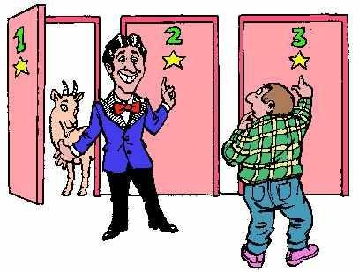
Monty Hall Problem

Slide 28
Monty Hall Problem Using Bayes Theorem
Let C₁, C₂, and C₃ be the events that the car is behind door 1, 2, and 3, respectively. Let D₁, D₂, and D₃ be the events that Monty opens door 1, 2, and 3, respectively. Prior probabilities of C₁, C₂, and C₃ are
P(C₁) = P(C₂) = P(C₃) = 1/3
Assume that the player has chosen door 1 and Monty opens door 2 to reveal a goat. Now we would like to calculate the posterior probability P(C₁|D₂), that is, the probability that the car is behind door 1 (door chosen initially by the player) when Monty has provided the additional information that the car is not behind door 2

Slide 29
Using, Bayes theorem
_{P(C | D ) =} P(D₂ | C₁ ) × P(C₁ ) ₌ (1 / 2) × (1 / 3) _{= 1 / 3}
1 2
P(D ) (1 / 2)
P(D₂|C₁) = ¹(if the car is behind door 1, then Monty can open
2
2
either door 2 or 3)
1
P(D₂) = ₂
1
3
₌ 2
Note that P(C₂|D₂) = 0. Thus P(C₃|D₂) = 1 – P(C₁|D₂) = 1 –
3
Thus, changing the initial choice will increase the probability of winning the car. Alternatively,
_{P(C | D ) =} P(D₂ | C₃ ) × P(C₃ ) ₌ 1× (1 / 3) _{= 2 / 3}
3 2
P(D₂ ) (1 / 2)
P(D₂|C₃) = 1 (if the car is behind door 3 and the player has chosen door 1, Monty has to open door 2 with probability 1)

Slide 30
Using, Bayes theorem
_{P(C | D ) =} P(D₂ | C₁ ) × P(C₁ ) ₌ (1 / 2) × (1 / 3) _{= 1 / 3}
1 2
P(D₂ ) (1 / 2)
P(D₂|C₁) = (if the car is behind door 1, then Monty can open either door 2 or 3)
P(𝐷 ) = ¹
2
2
Note that P(C |D ) = 0.Thus P(C |D ) = 1 – P(C |D ) = 1– ¹ = ¹
2 2 3 2 1 2
3 2
Thus, changing the initial choice will increase the probability of
winning the car. Alternatively,
_{P(C | D ) =} P(D₂ | C₃ ) × P(C₃ ) ₌ 1× (1 / 3) _{= 2 / 3}
3 2
P(D₂ ) (1 / 2)
P(D₂|C₃) = 1 (if the car is behind door 3 and the player has chosen door 1, Monty has to open door 2 with probability 1)

Slide 31
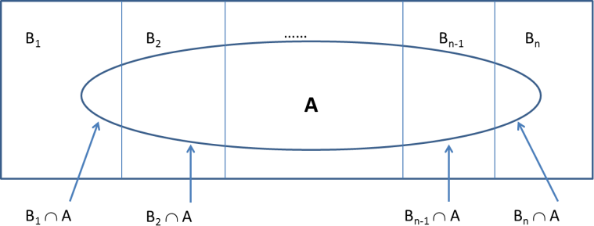
GENERALIZATION OF BAYES THEOREM
Event generated from mutually exclusive subsets
© U Dinesh Kumar, IIM Bangalore
Business Analytics – The Science of Data Driven Decision Making

Slide 32
Bayes’ Theorem
_{P(B | A) =} P( A | B)P(B)
P( A)
P( A) = P( A | B₁ )P(B₁ ) + P( A | B₂ )P(B₂ ) +... + P( A | B_{n} )P(B_{n} )

Slide 33
Example 3.4
Black boxes used in aircrafts manufactured by three companies A, B and C. 75% are manufactured by A, 15% by B, and 10% by C. The defect rates of black boxes manufactured by A, B, and C are 4%, 6%, and 8%, respectively. If a black box tested randomly is found to be defective, what is the probability that it is manufactured by company A?

Slide 34
Solution to Example 3.4
Let P(A), P(B), P(C) be events corresponding to the black box being manufactured by companies A, B, and C, respectively, and P(D) be the probability of defective black box. We are interested in calculating the probability P(A|D).
_{P( A | D) =} P(D | A) × P( A)
P(D)
Now P(D|A) = 0.04 and P(A) = 0.75. Using Eq.
P(D) = 0.75 × 0.04 + 0.15 × 0.06 + 0.10 × 0.08 = 0.047
So,
P( A | D) = ^{0.04 × 0.75} = 0.6382
0.047

Slide 35
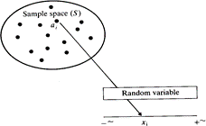
Random Variables
Random variable is a function that maps every outcome in the sample space to a real number.
A function that assigns a
real number to each
the
sample point in
sample space S.
Random variable is a robust and
convenient
way of representing
the
outcome of a random experiment
Business Analytics – The Science of Data Driven Decision Making

Slide 36
Discrete Random Variables
If the random variable X can assume only a finite or countably infinite set of
values, then it is called a discrete random variable.
Examples of discrete random variables are:
Credit rating (usually classified into different categories such as low, medium and high or using labels such as AAA, AA, A, BBB, etc.).
Number of orders received at an e-commerce retailer which can be
countably infinite.
Customer churn (the random variables take binary values, 1. Churn and 2. Do not churn).
Fraud (the random variables take binary values, 1. Fraudulent transaction and 2. Genuine transaction).
Any experiment that involves counting (for example, number of returns in a day from customers of e-commerce portals such as Amazon, Flipkart; number of customers not accepting job offers from an organization).

Slide 37
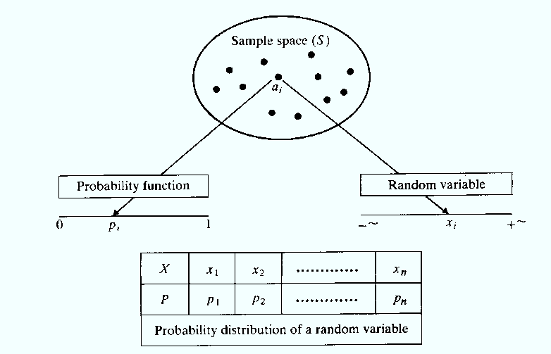
Probability mass function
For a discrete random variable, the probability that a random variable X taking a specific value x_{i}, P(X = x_{i}), is called the probability mass function P(x_{i}).
That is, a probability mass function is a function that maps each outcome of a random experiment to a probability
Business Analytics – The Science of Data Driven Decision Making

Slide 38
Expected Value
Expected value (or mean) of a discrete random variable is given by
E( X ) = ∑ x_{i} P(x_{i} )
i =1
n
Where x_{i} is the specific value taken by a discrete random variable X and P(x_{i}) is the corresponding probability, that is, P(X = x_{i}).

Slide 39
Variance and Standard Deviation
Variance of a discrete random variable is given by
n
Var(X ) = ∑ x − E( X ) × P(x )
[ ]
2
i i
i=1
Standard deviation of a discrete random variable is given by
σ = VAR( X )

Slide 40
Probability Density Function (pdf)
The probability density function, f(x_{i}), is defined as probability that the value of random variable X lies between an infinitesimally small interval defined by x_{i} and x_{i} + δx
_{f (x) = lim} P(x_{i} ≤ X ≤ x_{i} + δx)
δx→0
δx

Slide 41
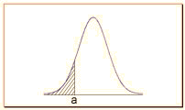
Cumulative Distribution Function (CDF)
The cumulative distribution function (CDF) of a continuous random variable is defined by
a
F (a) = P( X ≤ a) = ∫ f (x)dx
−∞
Cumulative distribution function

Slide 42
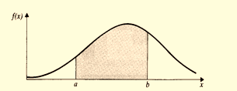
Probability density function and cumulative distribution function of a continuous random variable satisfy the following properties
The probability between two values a and b, P(a ≤ X ≤ b), is the area between the values a and b under the probability density function
f(x) ≥ 0
+∞
F (∞) = ∫ f (x)dx = 1
−∞
b
P(a ≤ X ≤ b) = ∫ f (x)dx = F(b) − F(a)
a
Business Analytics – The Science of Data Driven Decision Making

Slide 43
The expected value of a continuous random variable,
E(X), is given by
+∞
E( X ) = ∫ xf (x)dx
−∞
The variance of a continuous random variable,Var(X), is given by
Var( X ) = ∫ [x − E(x)]² f (x)dx
−∞
∞

Slide 44
Binomial Distribution
A random variable X is said to follow a Binomial distribution when
The random variable can have only two outcomes success
and failure (also known as Bernoulli trials).
The objective is to find the probability of getting k
successes out of n trials.
The probability of success is p and thus the probability of failure is (1 − p).
The probability p is constant and does not change between trials.

Slide 45
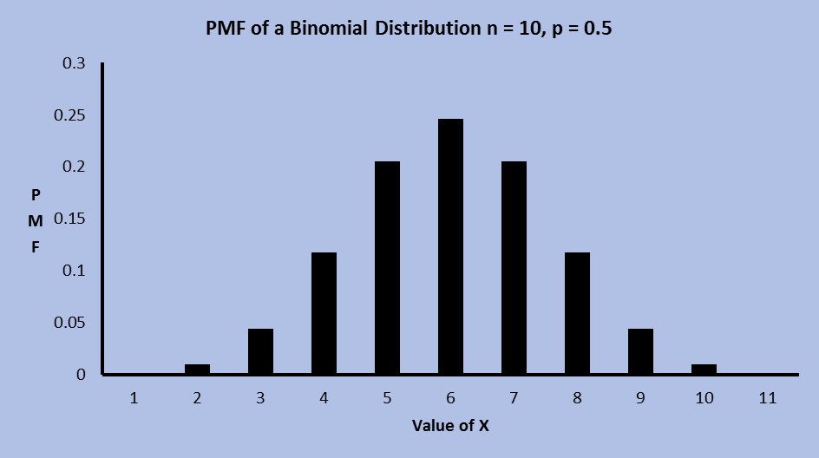
Probability Mass Function (PMF) of Binomial Distribution
The PMF of the Binomial distribution (probability that the number of success will be exactly x out of n trials) is given by
⎛ n⎞
x n− x
PMF(x) = P( X = x) = ⎜_{⎜ x} ⎟⎟ p (1 − p)
, 0 ≤ x ≤ n
⎝ ⎠
Where
⎛ n ⎞
n!
⎜ ⎟ =
⎝ ^{x} ⎠
x!(n − x)!

Slide 46
Mean and Variance of Binomial Distribution
The Mean of a binomial distribution is given by:
Mean = E( X ) = ∑ x × PMF(x) = ∑ x × ^{⎛ n ⎞} p^{x} (1− p)^{n− x} = np
n n
⎜ _{x} ⎟
x=0 x=0
⎝ ⎠
The variance of a binomial distribution is given by
Var( X ) = ∑(x − E( X ))² × PMF(x) = ∑(x − E( X ))² ×^{⎛ n ⎞} p^{x} (1 − p)^{n− x} = np(1 − p)
n n
⎜ _{x} ⎟
x=0 x=0
⎝ ⎠
If the number of trials (n) in a binomial distribution is large, then it can be approximated by normal distribution with mean np and variance npq.

Slide 47
Example 3.5
Fashion Trends Online (FTO) is an e-commerce company that sells women apparel. It is observed that about 10% of their customers return the items purchased by them for many reasons (such as size, color, and material mismatch). On a particular day, 20 customers purchased items from FTO. Calculate:
Probability that exactly 5 customers will return the items.
Probability that a maximum of 5 customers will return the items.
Probability that more than 5 customers will return the items
purchased by them.
Average number of customers who are likely to return the items.
The variance and the standard deviation of the number of
returns.

Slide 48
Solution
In this case, the value of n = 20 and p = 0.1.
(a) Probability that exactly 5 customers will return the items purchased is
⎛ 20⎞
5 15
P( X = 5) = ⎜ ⎟ × (0.1) × (0.9) = 0.03192
5
(b) Probability that a maximum⎝ of⎠ 5 customers will return the items purchased is
5
⎛ 20⎞
k 20−k
P( X ≤ 5) = ∑ ⎜
k
⎟ × (0.1) × (0.9) = 0.9887
k =0 ⎝ ⎠
(c) Probability that more than 5 customers will return the product is
5
⎛ 20⎞
k 20−k
P( X > 5) = 1− P( X ≤ 5) = 1− ∑ ⎜⎜ _{k}
⎟⎟ × (0.1) × (0.9) = 1− 0.9887 = 0.0113
k =0 ⎝ ⎠
The average number of customers who are likely to return the items is
E(X) = n × p = 20 × 0.1 = 2
Variance of a binomial distribution is given by
Var(X) = n × p × (1 − p) = 20 × 0.1 × 0.9 = 1.8
and the corresponding standard deviation is 1.3416

Slide 49
Poisson Distribution
Poisson distribution is used when we have to find the probability of number of events
The probability mass function of a Poisson distribution is given by
_{e}−λ _{× λ}k
P(X = k) = , k = 0, 1, 2, ...
k !
where λ is the rate of occurrence of the events per unit of measurement
Cumulative distribution function of a Poisson distribution is given by
_{e}−λ _{× λ}k
P[ X ≤ k] = ∑
i =0
k
k !

Slide 50
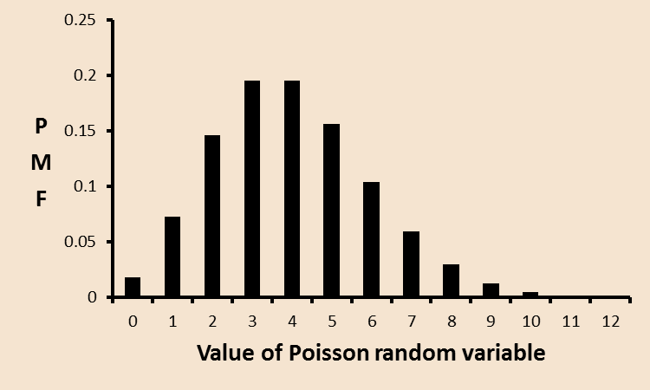
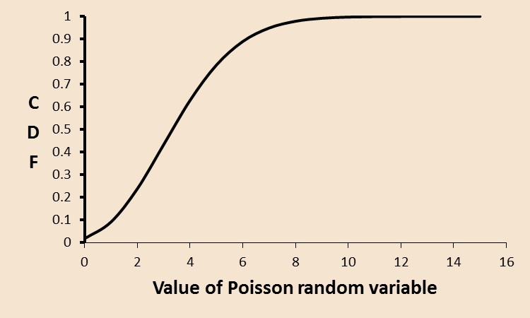
The mean and variance of a Poisson random variable are given by
E( X ) = λ
and
Var( X ) =λ
Probability mass function of a Poisson random variable (λ = 4).
Cumulative distribution function of a Poisson random variable (λ = 4).

Slide 51
Example
On average, about 20 customers per day cancel their order placed at Fashion Trends Online. Calculate the probability that the number of cancellations on a day is exactly 20 and the probability that the maximum number of cancellations is 25
Solution
The probability that the number of cancellations is exactly 20 is given by
_{e}−20 ₂₀20
P( X = 20) = = 0.0888
20!
Probability that the maximum number of cancellation will be 25 is given by
_{25 e}−20 ₂₀k
P( X ≤ 25) = ∑
= 0.8878
k =0
k!

Slide 52
Geometric Distribution
Geometric distribution represents a random experiment in which the random variable predicts the number of failures before the success
The probability density function of a geometric distribution is given by
P( X = x) = P(success at xth trial) = (1 − p)^{x−1} p, where x = 1, 2, 3, ...
The cumulative distribution function is given by:
F (x) = P( X ≤ x) = 1 − (1 − p)^{x}
Mean and variance of a geometric distribution are given by E( X ) = ¹
p
and
Var( X ) = ^{(1 − p)}
_{p}2

Slide 53
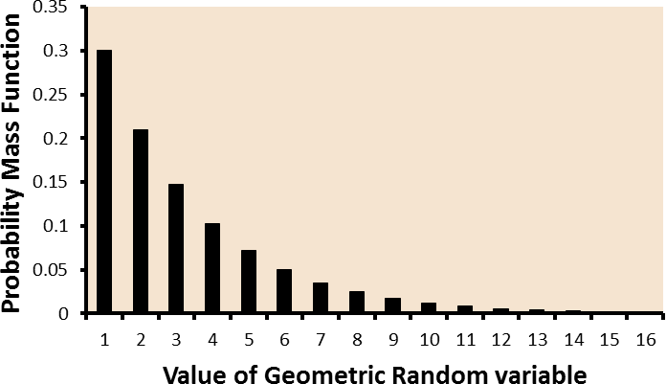
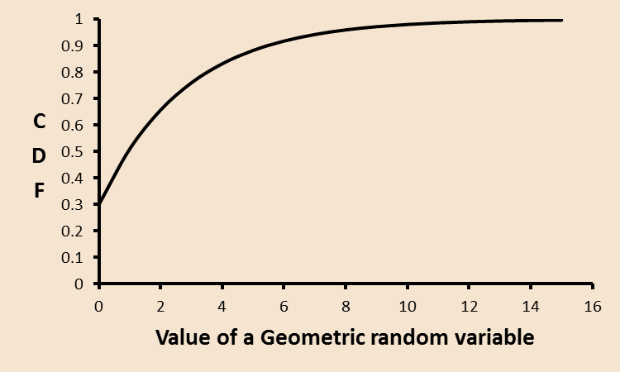
Cumulative distribution function of a geometric distribution (p = 0.3).
Probability mass function of a geometric distribution (p = 0.3).
Business Analytics – The Science of Data Driven Decision Making

Slide 54
Memoryless Property of Geometric Distribution
Memoryless property is a special property of a geometric distribution in
which the conditional probability, P(X > i + j | X > i),
value j, not on the value i.We know that
P(X > i) =1− P(X ≤ i) =1−[1− (1− p)^{i} ] = (1− p)^{i}
depends only on the
P(X > i + j ∩ X > i) P(X > i + j) (1− p)^{i+ j}
P(X > i + j | X > i) = = =
= (1− p)
j
P(X > i)
P(X > i) (1− p)^{i}
Note that, P( X > j) = (1 − p) ^{j} Thus, P(X > i + j | X > i) = P(X > j).
Memoryless property is an important property that simplifies calculations associated with conditional probabilities

Slide 55
Example
Local Dhaniawala (LD) is an online grocery store and has an innovative feature which predicts whether the customer has forgotten to buy an item which is very common among customers of grocery items. The probability that a customer buys milk in each shopping visit is 0.2.
Calculate the probability that the customer’s first purchase of milk
happens during the 5th visit.
Calculate the average time between purchases of milk.
If a customer has not purchased milk during the past 3 shopping visits, what is the probability that the customer will not buy milk for another 2 visits?

Slide 56
Solution
Probability that the customer’s first purchase of milk happens
on 5th trip is given by
P( X = 5) = (1 − 0.2)⁴ × 0.2 = 0.08192
The average time between purchase of milk is
1
E( X ) = ¹ =
= 5
p 0.2
(c) Given that a customer has not purchased milk for the past 3 shopping visits, the probability that the customer will not buy for another 2 visits is given by
P( X > 3 + 2 | X > 3) = P( X > 2) = (1 − p)² = (1 − 0.2)² = 0.64

Slide 57
Parameters of Continuous Distributions
Scale parameter: Scale parameter defines the range of the continuous distribution. The larger the scale parameter value, larger is the spread of the distribution.
Shape parameter: Shape parameter defines the shape of the probability distribution. The changes to the value of shape parameter will change the shape of the distribution.
Location parameter: Location parameter locates (or shifts) the distribution on the horizontal axis.

Slide 58
Exponential Distribution
Exponential distribution is a single parameter continuous distribution that is
traditionally used for modelling time to failure of electronic components
The probability density function and cumulative distribution of exponential distribution are given by
f (x) = λe^{−λx} , λ > 0
F (x) = 1 − e^{−λx}
The parameter λ is the scale parameter and represents the rate of occurrence of the event, (1/λ) is the mean time between events.

Slide 59
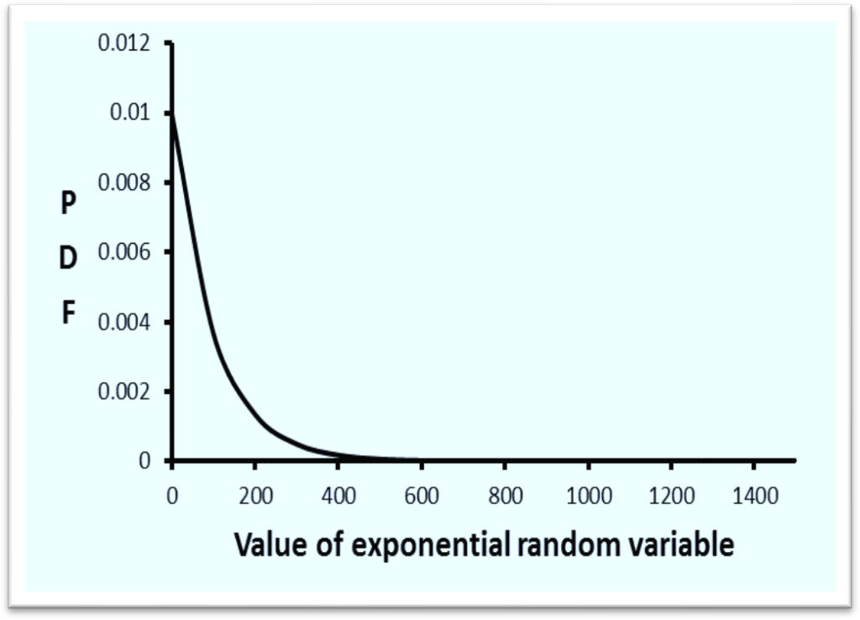
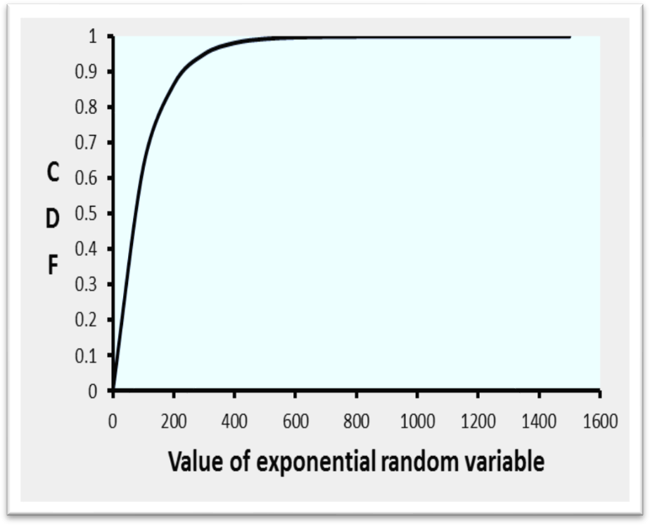
Probability density function of an exponential distribution
The mean and variance of an exponential distribution are given by
E ( X ) = ¹ and
Var( X ) =
1
λ
_{λ}2
The expected value (1/λ) is the mean time between events.
Business Analytics – The Science of Data Driven Decision Making

Slide 60
Memoryless Property of Exponential Distribution
Exponential distribution is the only continuous probability distribution that has the memoryless property.That is ,
P(X > t + s | X > t) = P(X > s)
_{P(X > t + s | X > t) =} P(X > t + s ∩ X > t) ₌ P(X > t + s) ₌ e^{−λ(t+s)} _{= e−λs}
P(X > t) P(X > t)
_{e}−λt

Slide 61
Example
The time to failure of an avionic system follows an exponential distribution with a mean time between failures (MTBF) of 1000 hours.
Calculate the probability that the system will fail before 1000
hours.
Calculate the probability that it will not fail up to 2000 hours.
Calculate the time by which 10% of the systems will fail (that is
calculate P₁₀ life)

Slide 62
Solution
(a) The probability that the system will fail by 1000 hours is
F (1000) = 1 − e^{λt}
In this case
− ¹ ×1000
−
λ = 1 / 1000, t = 1000
^{so ,} F (1000) = 1 − e ¹⁰⁰⁰
= 1 − e ¹ = 0.6321
(b) The probability that the system will not fail up to 2000 hours
is
−λ
− ¹ ×2000
1000
P( X > 2000) = 1− P( X ≤ 2000) = 1− F (t) = e ^{t} = e = e⁻² = 0.1353
(c) The time by which 10% of the systems will fail is
F(t) = 0.10 ⇒ 1− e^{−λt} = 0.1
e^{−λt} = 0.9
So ,
t = −^{⎛ 1 ⎞}ln(0.9) = −1000 × ln(0.9) = 105.61
hours
⎜ _{λ} ⎟
⎝ ⎠
That is, by 105.61 hours, 10% of items will fail.

Slide 63
Normal Distribution
Normal distribution, also known as Gaussian distribution, is one of the most popular continuous distribution in the field of analytics especially due to its use in multiple contexts
The probability density function and the cumulative distribution function are given by
1
1 ⎛ x−μ ⎞²
⎝ ⎠ ,
f (x) = e
⁻ ⎜ ⎟
2 σ
− ∞ < x < +∞
σ 2π
x
1
1 ⎛ t −μ ⎞²
F (x) = ∫
⁻ ⎜ ⎟
2 σ
e ⎠ dt, − ∞ < x < +∞
⎝
_{−∞} σ 2π
Here μ and σ are the mean and standard deviation of the normal distribution

Slide 64
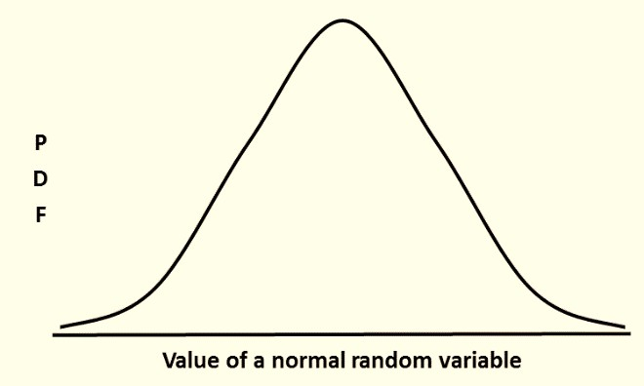
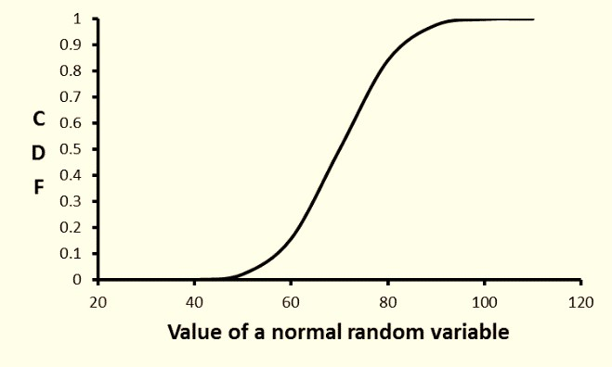
NORM.DIST(x, μ, σ, true) can be used for calculating the probability density function and cumulative distribution function of a normal distribution with mean μ and standard deviation σ.
Probability density function of a normal distribution
Cumulative distribution function of a normal distribution.
Business Analytics – The Science of Data Driven Decision Making

Slide 65
Properties of Normal Distribution
Theoretical normal density functions are defined between
−∞ and +∞.
It is a two parameter distribution, where the parameter μ is the mean (location parameter) and the parameter σ is the standard deviation (scale parameter).
All normal distributions have symmetrical bell shape around mean μ (thus it is also median). μ is also the mode of the normal distribution, that is, μ is the mean, median as well as the mode.

Slide 66
4. For any normal distribution, the areas between specific values measured in terms of μ and σ are given by:
Value of Random Variable | Area under the Normal Distribution (CDF)
μ − σ ≤ X ≤ μ + σ (area between one sigma from the mean) | 0.6828
μ − 2σ ≤ X ≤ μ + 2σ (area between two sigma from the mean) | 0.9545
μ − 3σ ≤ X ≤ μ + 3σ (area between three sigma from the mean) | 0.9973
5. Any linear transformation of a normal random variable is also normal random variable. That is, if X is a normal random variable, then the linear transformation AX + B (where A and B are two constants) is also a normal random variable.

Slide 67
with mean μ and μ and variance and respectively, then
If X₁ and X₂ are two independent normal random variables
2
_{σ} 2
1 2
σ₁
2
X1 + X2 is also a normal distribution with mean μ1 + μ2 and
variance σ ² + σ ²
1 2
Sampling distribution of mean values a large sample drawn form a population of any distribution is likely to follow a normal distribution, this result is known as the central limit theorem

Slide 68
Standard Normal Variable
A normal random variable with mean μ = 0 and σ = 1 is called
the standard normal variable and usually represented by Z
The probability density function and cumulative distribution function of a standard normal variable are given by
_{z} 2
1
2π
f ( z) =
e
2
_{− x}2
z
F (z) = ∫
−∞
1
e ² dz
2π

Slide 69
By using the following transformation, any normal random variable X can be converted into a standard normal variable
_{Z =} X − μ
σ
The random variable X can be written in the form of a standard normal random variable using the relationship
X = μ + σ Z

Slide 70
A simple approximation of standard normal CDF is given by Tocher (1963)
_{e}2kz
P(Z ≤ z) = F(z) ≈
_{1 + e}2kz
k = 2 / π
where
Another more accurate approximation is provided by Byrc (2002):
⎛ ⎞
z ² + A₁z + A₂
− z ² / 2
P(Z ≤ z) = F (z) = 1 − ⎜
⎟ × e
⎜
2π × z³ + B₁z ² + B₂ z + 2 A₂ ⎟
⎝
⎠

Slide 71
Example
According to a survey on use of smart phones in India, the smart phone users spend 68 minutes in a day on average in sending messages and the corresponding standard deviation is 12 minutes. Assume that the time spent in sending messages follows a normal distribution.
What proportion of the smart phone users are spending more than 90 minutes in sending messages daily?
What proportion of customers are spending less than 20 minutes?
What proportion of customers are spending between 50
minutes and 100 minutes?

Slide 72
Solution
It is given that μ = 68 minutes and σ = 12 minutes.
(a) Proportion of customers spending more than 90 minutes is given by P(X
≥ 90) = 1 − P(X ≤ 90) = 1 − F(90)
The standard normal random variable value for X = 120 is given by
Z = ^{x − μ} = ⁹⁰ ⁻ ⁶⁸ = 1.8333
σ
12
That is, F(X = 90) = F(Z = 1.8333). From standard normal distribution table, we get for Z = 1.8333.The area under the standard normal distribution curve is 0.9666. Thus , P(X ≥ 90) = 1− P(X ≤ 90) = 1 − F(90) = 1 – 0.9666 = 0.0334
Alternatively, using Excel, we get
P(X ≥ 90) = 1 − P(X ≤ 90) = 1 – Normdist (90, 68, 12, true) = 0.0334

Slide 73
(b) Proportion of customers spending less than 20 minutes is
P(X ≤ 20) = F(20)
Using Excel function, we have Normdist(20, 68, 12, true) = 3.1671 × 10−5
(c) Proportion of customers spending between 50 and 100 minutes is given by
P(50 ≤ X ≤ 100) = F (100) − F (50)
= Normdist(100,68,12, true) − Normdist(50,68,12, true)
= 0.9293

Slide 74
Chi-Square Distribution
Chi-square distribution with k degrees of freedom [denoted as χ²(k) distribution] is a non-parametric distribution which is obtained by adding square of k independent standard normal random variables.
Consider a normal random variable X₁ with mean μ₁ and standard deviation σ₁. Then we can define Z₁ (the standard normal random variable) as
_{Z1 =} X₁ − μ₁
σ₁
Then,
2
⎛ X₁ − μ₁ ⎞²
Z₁ = ⎜
⎟
σ
⎝ 1 ⎠
is a chi-square distribution with one degree of freedom [χ2(1)]

Slide 75
Let X₂ be a normal random variable with mean μ₂ and standard deviation
σ₂ and Z₂ is the corresponding standard normal variable. Then the random
variable
_{Z} 2
+ Z ²
given by
1
2
2 2
⎛ X₁ − μ₁ ⎞²
⎛ X ₂ − μ₂ ⎞²
Z₁ + Z₂ = ⎜
σ
⎟ + ⎜
1 ⎠ ⎝
σ
⎟
2 ⎠
⎝
is a chi-square distribution with 2 degrees of freedom.
A chi-square distribution with k degrees of freedom is given by sum of squares of standard normal random variables Z1, Z2, …, Zk obtained by transforming normal random variables X1, X2, …, Xk with mean values μ1,
μ2, …, μk and corresponding standard deviations σ1, σ2, …, σk. That is
⎛ X − μ ⎞² ⎛ X − μ ⎞²
⎛ X − μ ⎞²
2 2 2 2
1 1 _{⎟ + ⎜} 2 2 ⎟
⎝ ^{σ}1 ⎠ ⎝ ^{σ} 2 ⎠
k k ⎟
⎝ ^{σ}k ⎠
χ (k) = Z₁ + Z₂ + ... + Z_{k} = ⎜
+ ... + ⎜

Slide 76
The probability density function of χ²(k) is given by
k ₋₁ ₋ x
1
_{x} 2
f (x) =
e
2
k 2
2 Γ(k 2)
where Γ(k / 2)
is a Gamma function given by
∞
Γ(k ) = ∫ x^{k −1}
0
e^{− x}dx

Slide 77
The cumulative distribution function of a chi-square distribution with k degrees of freedom is given by
_{γ} ⎛
k x ⎞
⎜
,
₂ ⎟
F ( x) =
⎝
2
⎠
_{Γ} ⎛
k
⎞
⎜ ₂ ⎟
⎝ ⎠
Where
γ
⎛ k x ⎞
is the lower incomplete Gamma function. It is
⎜ ₂ , ₂ ⎟
⎝
⎠
given by
x
k −1_{e}−t
γ (k, x) = t
dt
∫
0

Slide 78
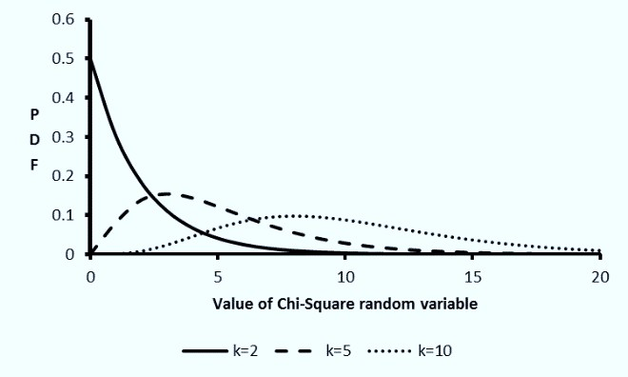
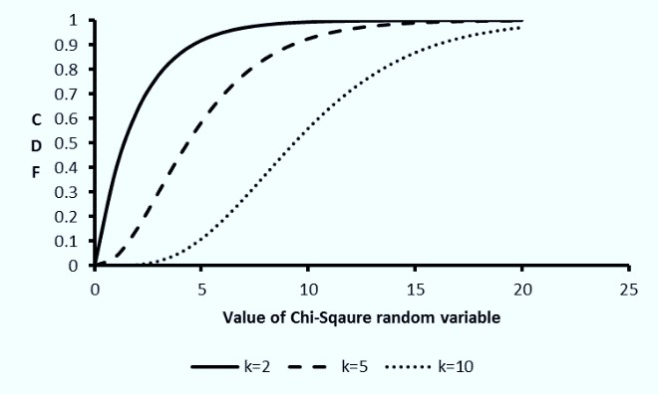
Cumulative distribution of chi- square distribution with k degrees of freedom
Probability density function of chi- square distribution for different values of k
Business Analytics – The Science of Data Driven Decision Making

Slide 79
Properties of chi-square distribution
The mean and standard deviation of a chi-square distribution
2k
are k and where k is the degrees of freedom
As the degrees of freedom k increases the probability density function of a chi-square distribution approaches normal distribution.
Chi-square goodness of fit test is one of the popular tests for checking whether a data follows a specific probability distribution.

Slide 80
Student’s t-Distribution
Student’s t-distribution (or simply t-distribution) arises while estimating the population mean of a normal distribution using sample which is either small and/or the population standard deviation is unknown
The distribution was developed by William Gosset under the pseudo name ‘student’ while working for Guinness Brewery in Dublin, Ireland (Student, 1908) and thus is called student’s distribution.

Slide 81
Assume that X₁, X₂, …, X_{n} are n observations (that is, sample of size n) from a normal distribution with mean μ and standard deviation σ. Let
−
n
∑ X _{i} i =1
X =
n ⎛
_{− ⎞}2
1
S = ∑⎜ X_{i} − X ⎟
n −1
i=1⎝
⎠
where and S are mean and standard deviation estimated from the
−
X
sample X1, X2, …, Xn. Then the random variable t defined by
−
_{t =} X − μ
S / n
follows a t-distribution with (n − 1) degrees of freedom.

Slide 82
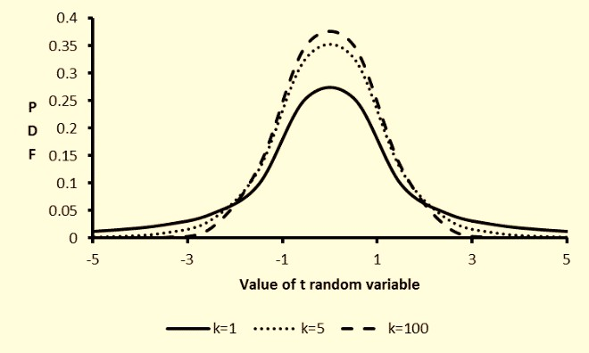
The probability density function of t-distribution with n
degrees of freedom is given by
⎛ n + 1 ⎞
n+1 2
Γ⎜
⎟ ⎛
2
x² ⎞⁻
f (x) = ⎝ ⎠ ⎜1 +
⎟
_{Γ}⎛ n ⎞
n ⎠
⎜ ₂ ⎟
nπ ⎝
⎝ ⎠

Slide 83
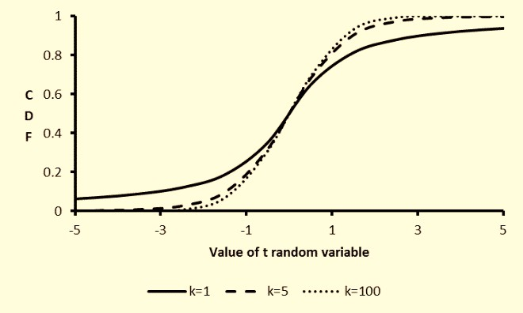
Cumulative distribution function of student’s t-distribution

Slide 84
Properties of t-distribution:
The mean of a t distribution with 2 or more degrees of freedom is
0.
The standard deviation of t-distribution is the number of degrees of freedom.
n n − 2
for n > 2, where n is
As the degrees of freedom n increases the probability density function of a t-distribution approaches the density function of standard normal distribution. For n > 120, the difference between the area under probability density function of a t-distribution is very close to the area under a standard normal distribution.
t-distribution is an important distribution for hypothesis testing of means of a population and for comparing means of two populations.

Slide 85
F-Distribution
F-distribution (short form of Fisher’s distribution named after statistician Ronald Fisher) is a ratio of two chi-square distributions. Let Y₁ and Y₂ be two independent chi-square distributions with k₁ and k₂ degrees of freedom, respectively.Then the random variable X is defined as
Y₁ / k₁
X =
Y₂ / k₂
is a F distribution. The probability density function of an F-distribution is given by
⎛ k₁ + k₂ ⎞⎛ k₁ ⎞^{k1 / 2}
Γ⎜ ⎟⎜ ⎟
k
1 ₋₁
_{x} 2
k₁ + k₂
f (x) = ^{⎝ 2 ⎠⎝ k2 ⎠} ×
_{Γ}⎛ k₁ ⎞_{Γ}⎛ k₂ ⎞
⎜ ₂ ⎟ ⎜ ₂ ⎟
⎛
k₁x ⎞ 2
⎝ ⎠ ⎝ ⎠
⎜1+
k
⎟
⎝
2 ⎠

Slide 86
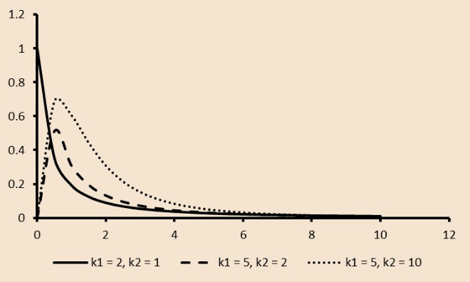
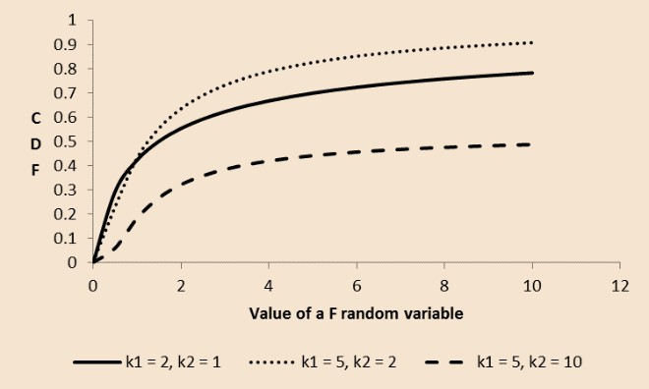
Probability density function of F-
distribution
Cumulative density function of F-
distribution
Business Analytics – The Science of Data Driven Decision Making

Slide 87
Properties of F distribution:
Mean of F-distribution is
k₂
k₂ − 2
,
for k2 > 2.
Standard deviation of F-distribution is for k2 > 4.
2k ² (k₁ + k₂ − 2)
2
k₁(k₂ − 2)² (k₂ − 4)
F-distribution is non-symmetrical and the shape of the distribution
depends on the values of k1 and k2.
F-distribution is used in Analysis of Variance to test the mean values of
multiple groups

Slide 88
Summary
The concept of probability, random variables and probability distributions are foundations of data science. Knowledge of these concepts is important for framing and solving analytics problems.
Random variable is a function that maps an outcome of a random experiment to a real number and plays an important role in analytics since many key performance indicators used across industries are random variables.
Basic probability concepts such as joint events, independent events, conditional probability and Bayes’ theorem are useful for predicting probability of an event of importance. These concepts are used in algorithms such as association rule learning which is used in solving analytics problems such as market basket analysis and recommender systems.

Slide 89
Discrete probability distributions such as binomial distribution, Poisson distribution and geometric distribution are used for modelling discrete random variables.
Continuous distributions such as normal distribution, chi-square distribution, t-distribution and F-distribution play an important role in hypothesis testing.

